Slide 1

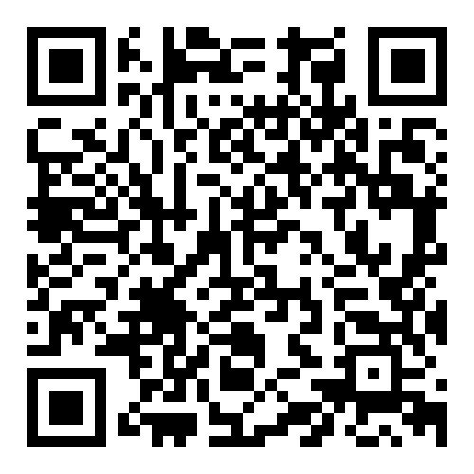
Leveraging KyFromAbove with Cloud-Friendly Tools
Ian Horn
Division of Geographic Information
2024 Kentucky GIS Conference
Email: ian.horn@ky.gov
https://ky.box.com/v/kyfromabove-cloud-kamp2024

Slide 2
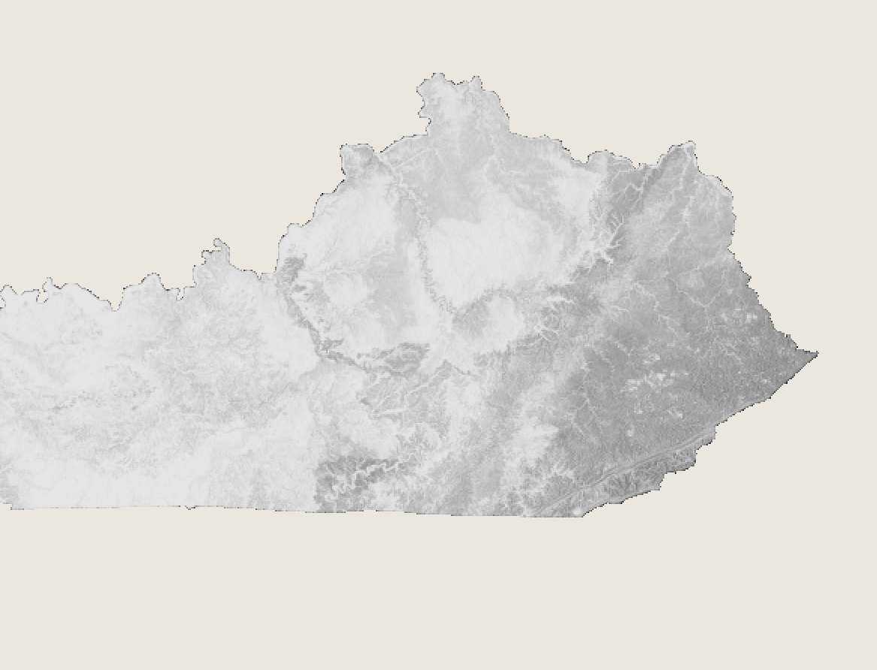
Overview
Rapid Overview of KyFrombove
Why make it Open?
Open Data Registry on AWS
Where
Stream
Create
SpatioTemporal Asset Catalog (STAC)
Demo?
What’s next?

Slide 3
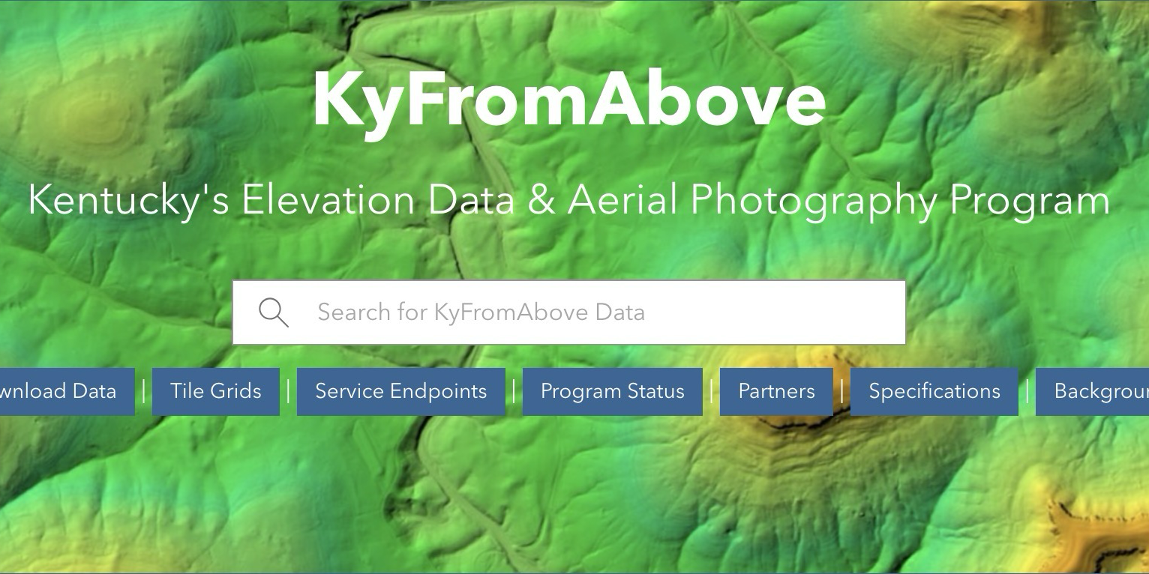

Notes:
KyFromAbove
–
- focused around a bulding/maintaining a common basemap
–

Slide 4
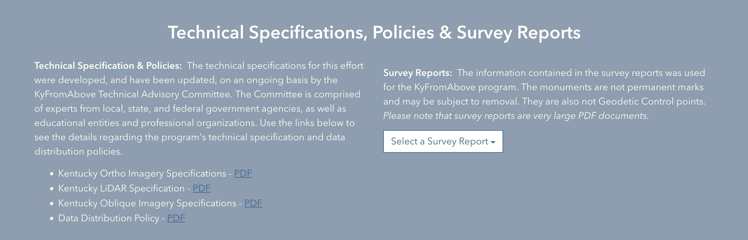

Slide 5

KyFromAbove is Freely Available in Public Domain
Advantages
Increases Return on Investment
Invites Investment
Fosters Collaboration
Supports Research
Promotes Interoperability
Identifies Authoritative Sources
Cost Avoidance Measure
AND MANY OTHERS

Slide 6

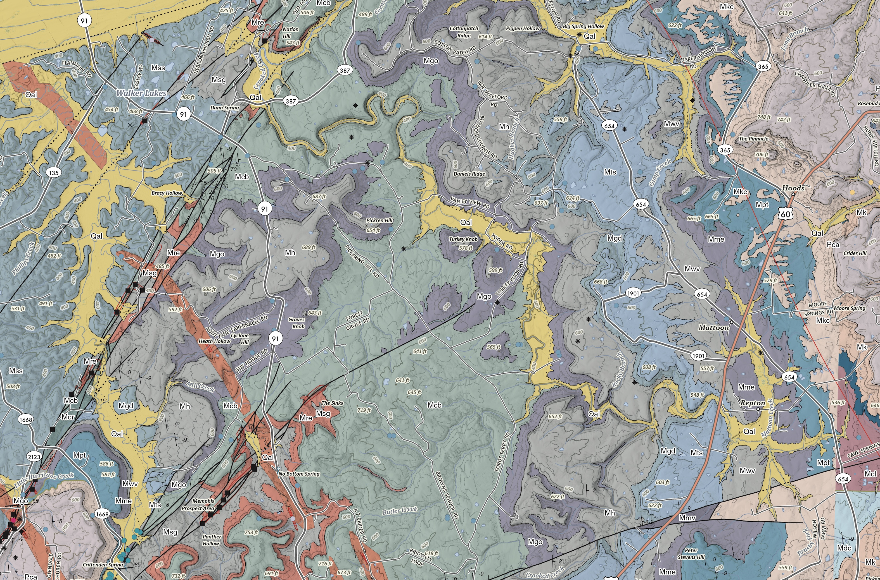
Beneficiaries of Open Data Access
Kentucky GIS Community
Emergency response efforts
Units of local government
Federal agencies
First responders
PVAs
Engineers
Surveyors
Academia
Kentuckians

Slide 7
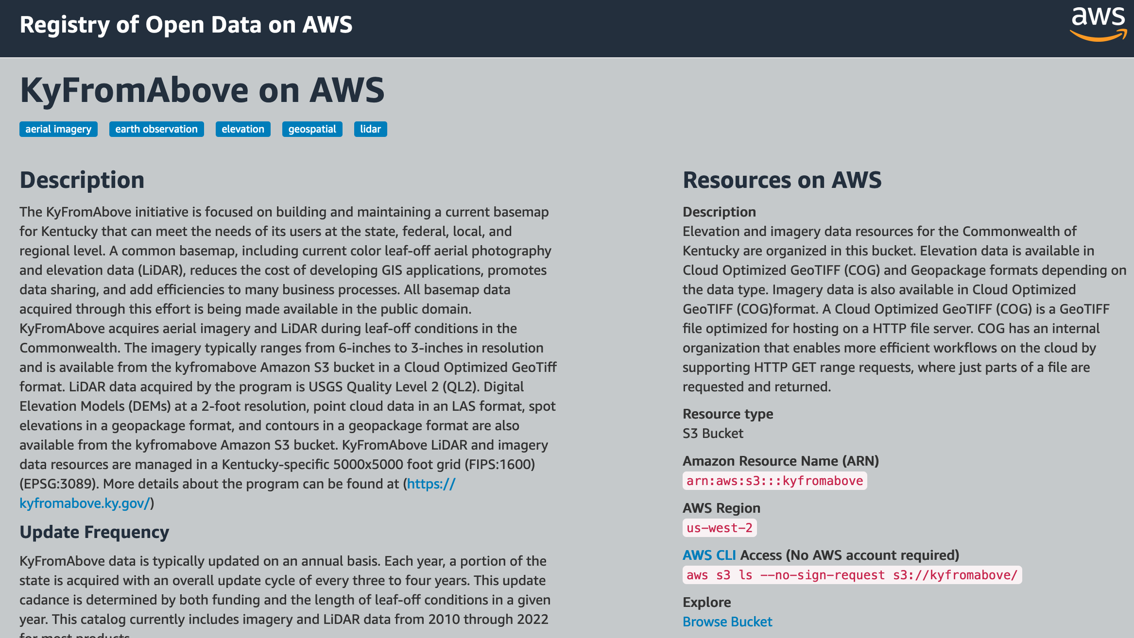
Notes:
https://kyfromabove.s3.us-west-2.amazonaws.com/elevation/PointCloud/Phase3/N116E401_LAS_Phase3.copc.laz

Slide 8
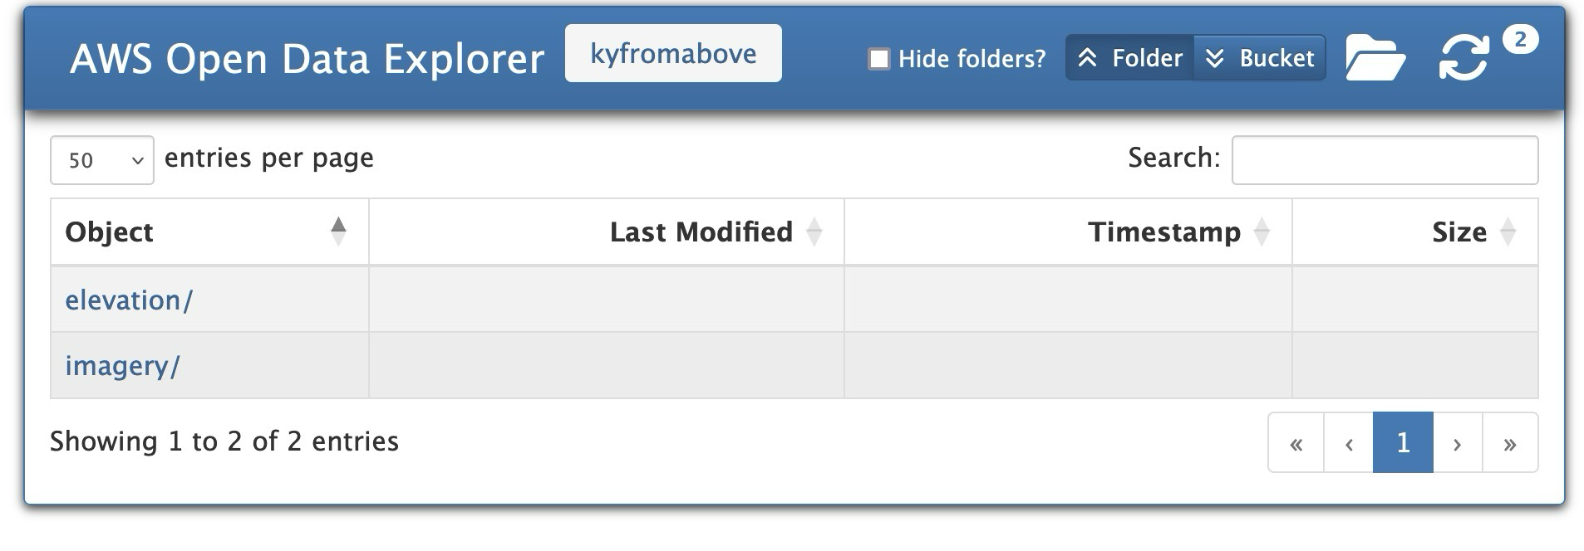
Notes:
https://kyfromabove.s3-us-west-2.amazonaws.com/elevation/PointCloud/Phase3/N093E390_LAS_Phase3.copc.laz

Slide 9
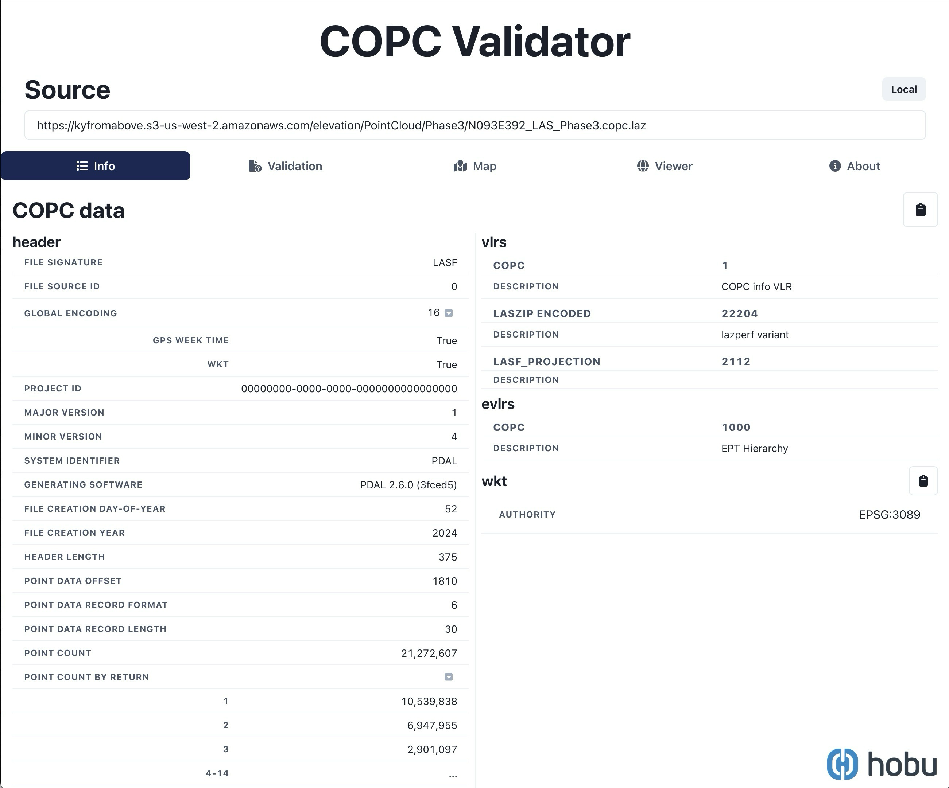
Notes:
https://kyfromabove.s3-us-west-2.amazonaws.com/elevation/PointCloud/Phase3/N093E390_LAS_Phase3.copc.laz
[default]
region = us-west-2
s3 =
max_concurrent_requests = 20
max_queue_size = 10000
multipart_threshold = 64MB
multipart_chunksize = 2MB
max_bandwidth = 50MB/s
addressing_style = path

Slide 10
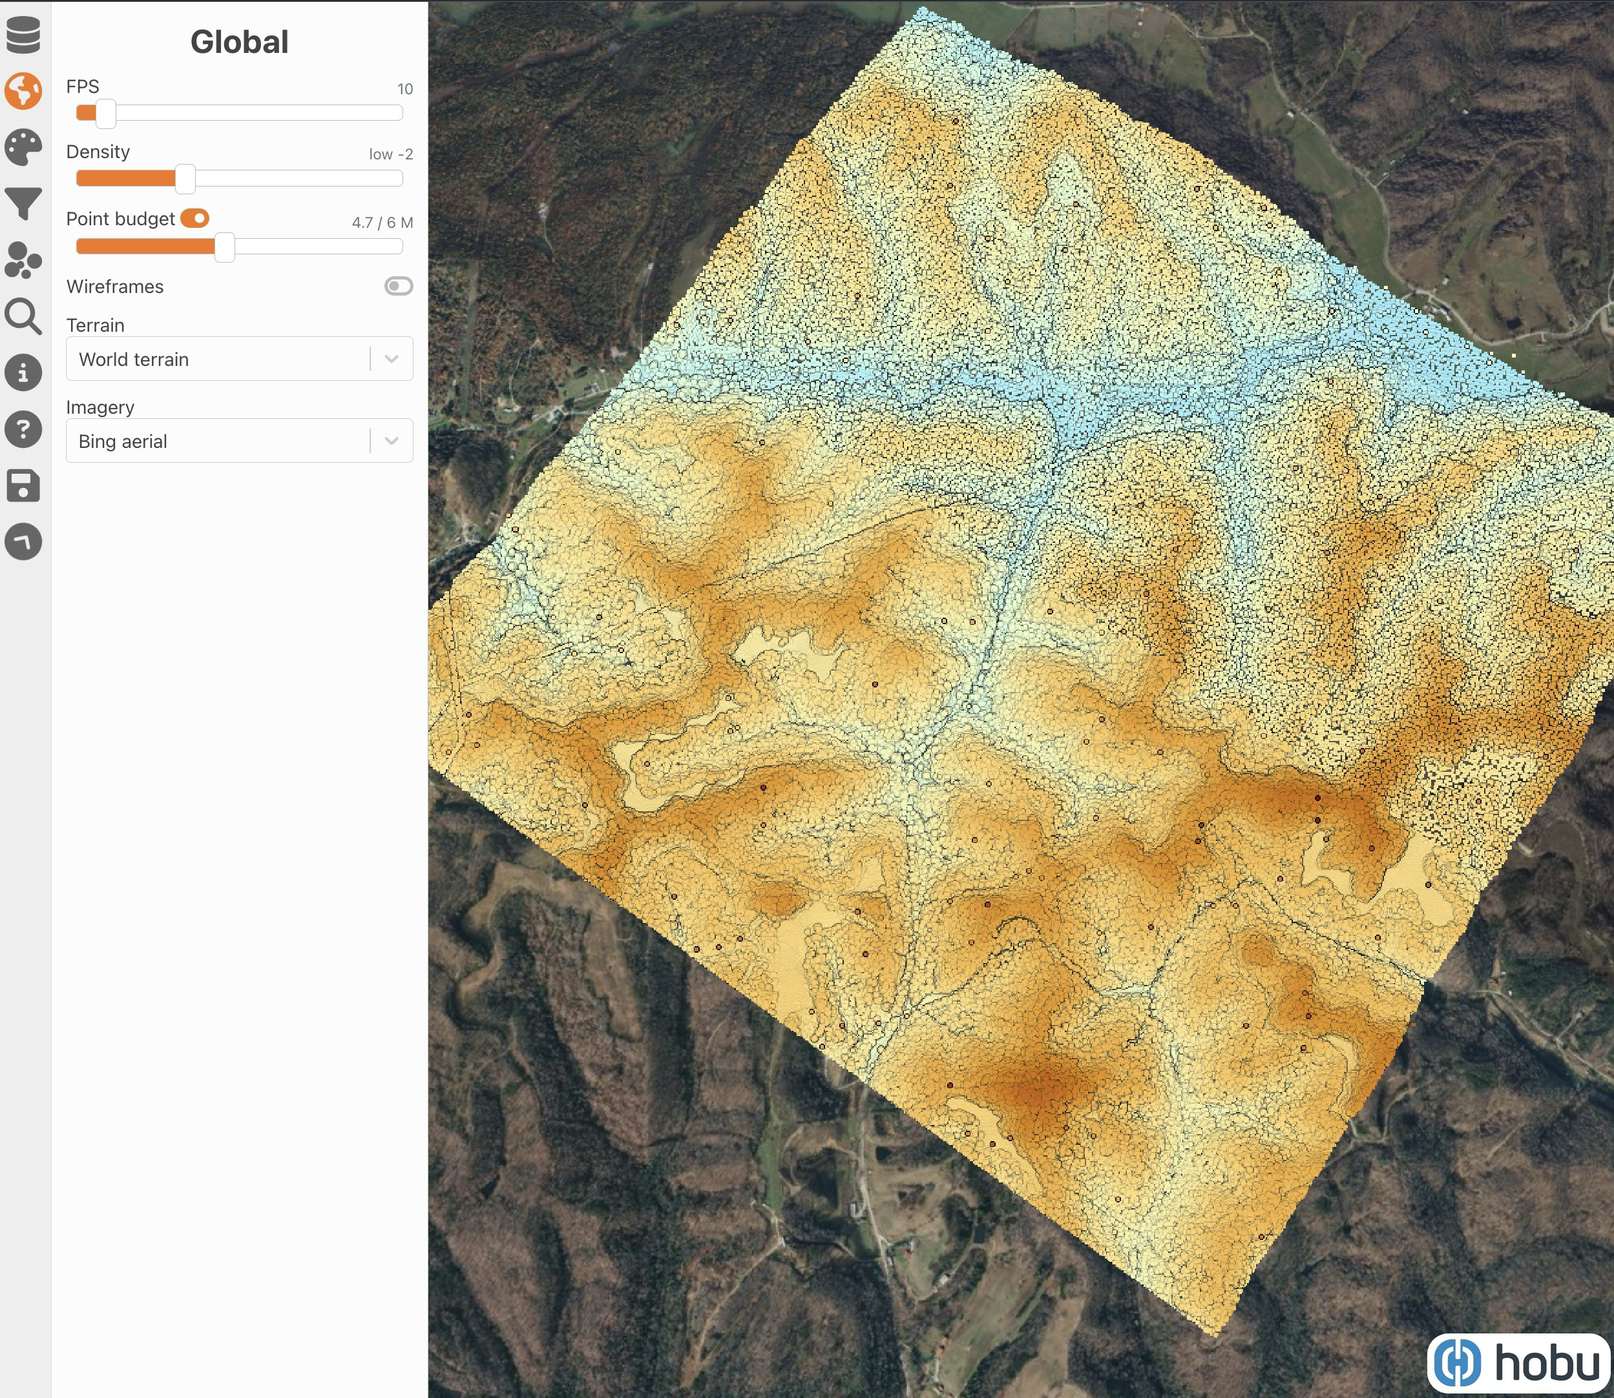
Notes:
https://viewer.copc.io?state=2b27a1f50b2ef005210857dd634c7625e538593f72aa3cc3a859d4b55c7fb310

Slide 11
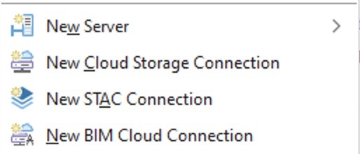
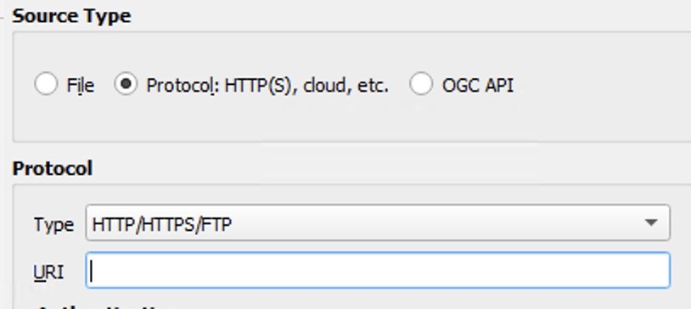
For Desktop Software
ArcGIS Pro
Cloud Storage Connection - .acs
(Optional)
STAC Connection - .astac
QGIS
AWS URL
(Optional)
STAC API Browser Plugin

Slide 12

Discoverability?

Slide 13


SpatioTemporal Asset Catalog
STAC
Data that has a SPACE and TIME component
where
when

Slide 14
STAC Fundamentals
STAC Item – core atomic unit
STAC Catalog – parent, simple and flexible, structure to organize and browse STAC Items
STAC Collection – extension of the Catalog, provides additional information (extents, license, keywords, etc.)
STAC API - provides a RESTful endpoint that enables search of STAC Items, specified in OpenAPI, following OGC's WFS 3.
https://stacspec.org/en
Notes:
The STAC Specification consists of 4 semi-independent specifications. Each can be used alone, but they work best in concert with one another.

Slide 15
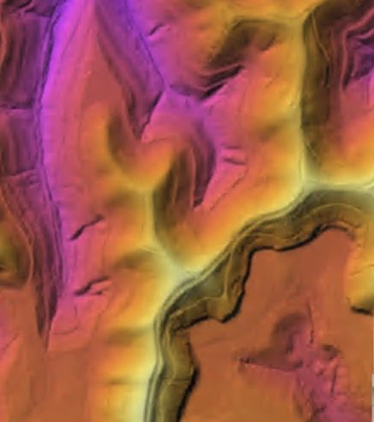
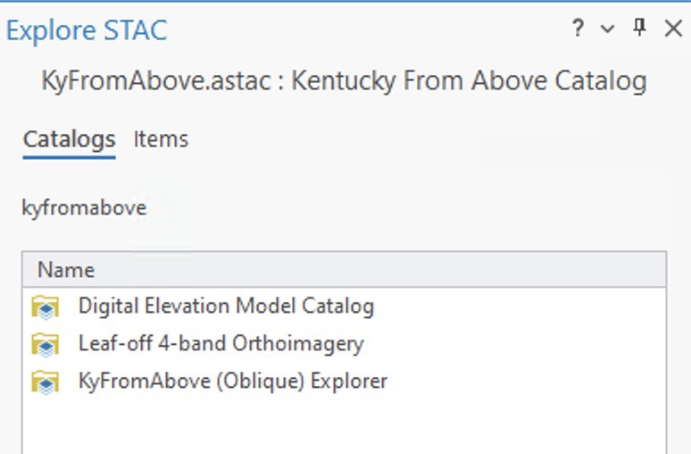
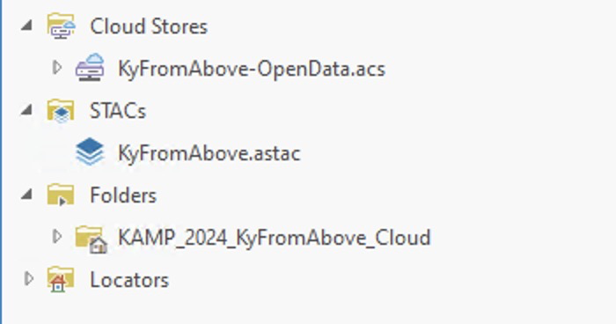
Demo

Slide 16
What next?
APPEND Static Catalog with new deliverables
Static catalog → API
What does this mean?
Find an API and just add our data as a collections
Stactools-packages, stactools pipelines
Other Federation Options – “One STAC to rule them all”
Get involved
We made it Open, help make it discoverable!

Slide 17


Thanks
The DGI Team, including Kent
You
AWS
ESIP

Slide 18
?
Email: ian.horn@ky.gov
Ian Horn
Division of Geographic Information
2024 Kentucky GIS Conference
https://ky.box.com/v/kyfromabove-cloud-kamp2024

